Slide 1
Introduction to NoSQL
Notes:
Show customer, order, order_line. And cross out.
Today NoSQL: they cannot handle relationship well

Slide 2
NoSQL
Very new technology – definitions are still under development
Agreement on:
Not relational
Highly distributable and scalable
High availability, fault tolerant
Supports sparse, and large amounts of data
Trades performance for transaction consistency
Notes:
Newer than relational
No rectangle table vs “table”
Fast, easy, large.
Data are not related.
Performance: store browser history vs very tiny info is important

Slide 3
Common Data Models
Column stores - optimized for queries over large datasets, stores columns together, e.g. Cassandra, HBase.
Document stores – each item is a key and a complex data structure (“document”) with many key-value pairs, key-array pairs, nested documents, and more.
Key-Value stores - simplest. Items stored an attribute name ("key") and value, e.g. Riak,Voldemort. Some, e.g. Redis, allow each value to have a type such as "integer”.
Graph stores - info about networks, such as social connections, e.g. Neo4J, HyperGraphDB.
Notes:
Document: mongoDB
Graph: Adjacency matrix.

Slide 4
Benefits (over Relational Model)
Supports large volumes of semi-structured data without pre-defined schema
Integrates with object-oriented programming techniques easily
Scales “out”
Sharding
Replication

Slide 5
Shortcomings
Non-relational
Not intended for uses requiring SQL, joins, or multi-object transactions
Technology is non-mature
Lack of a common query tool for use with analytics and business intelligence
Notes:
Sql for mysql, oracle, and others.

Slide 6
NoSQL Products
Numerous – Classification not yet defined
Examples
Oracle NoSQL
Cassandra (Apache)
BigTable (Google)
SimpleDB (Amazon)
MongoDB

Slide 7
MongoDB
Databases contain collections
Collections contain BSON (binary JSON) documents[1]
Documents contain field: value pairs
Common structure is not enforced on documents
[1] http://bsonspec.org/
Notes:
Not tables but collections

Slide 8
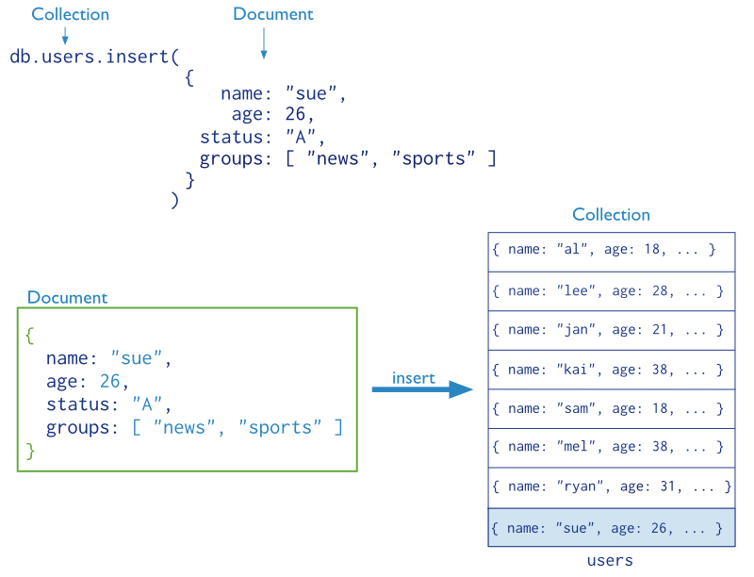
MongoDB-Example Insert
Retrieved from http://docs.mongodb.org/manual/core/crud-introduction
Notes:
[ ]: array

Slide 9
MongoDB - Documents
Structure
{
dealershipName: “NW Cars”,
yearOpened: 1995,
cars: [
{year: 2013, make: “Bear”, model: “Cat”, vin: 3928056, mechanicNotes: “Runs great!”},
{year: 1961, make: “Chevy”, model: “Impala”, vin: 8056309, mechanicNotes: “Great Scott!”}
]
}
Notes:
Nested documents. Or embedding

Slide 10
MongoDB – Data Modeling
Embedded documents
{
dealershipName: “NW Cars”,
yearOpened: 1995,
cars: [
{year: 2013, make: “Bear”, model: “Cat”, vin: 3928056, mechanicNotes: “Runs great!”},
{year: 1961, make: “Chevy”, model: “Impala”, vin: 8056309, mechanicNotes: “Great Scott!”}
]
}

Slide 11
MongoDB – Data Modeling
Document references
{ _id: 1111,
year: 2013,
make: “Bear”,
model: “Cat”,
vin: 3928056,
mechanicNotes: “Runs great!”
}
{ _id: 2222,
year: 1961,
make: “Chevy”,
model: “Impala”,
vin: 8056309,
mechanicNotes: “Great Scott!”
}
{ _id: 1234,
dealershipName: “NW Cars”,
yearOpened: 1995,
cars: [1111, 2222]
}

Slide 12
MongoDB – Data Modeling
Modeling relationships using references and embedding
Remember to use a RDMS for highly relational scenarios.

Slide 13
MongoDB – More Info
http://www.mongodb.org
Running on Windows and need to know your version & architecture?
Enter the following commands in the Command Prompt or Powershell:
wmic os get caption
wmic os get osarchitecture
Notes:
CRUD operation

Slide 14
MongoDB – CRUD Example
CRUD – Refers to database commands that Create, Read, Update, and Delete
The following example works with primer-dataset.json (see course site).
Import the database
mongoimport --db ADBRestaurants --collection restaurants --drop --file c:\dataIn\primer-dataset.json
use ADBRestaurants;
show collections;
db.restaurants.find();
db.restaurants.find().pretty();

Slide 15
MongoDB – CRUD (cont.)
Create
db.restaurants.count()
db.restaurants.insert( {restaurant_id: “123456"} )
db.restaurants.count()
Read
db.restaurants.find({name:"Carvel Ice Cream"}).pretty();
Update
db.restaurants.update( {restaurant_id: “123456"},
{$set: {name: “Happy Garden“, city:”Maryville”}})
db.restaurants.find( {restaurant_id: “123456"} ).pretty()

Slide 16
MongoDB – CRUD Example
Delete:
db.restaurants.count()
db.restaurants.count({name:"Carvel Ice Cream"});
db.restaurants.find({name:"Carvel Ice Cream"}).pretty();
db.restaurants.remove({name:"Carvel Ice Cream"});
db.restaurants.count()

